Slide 1

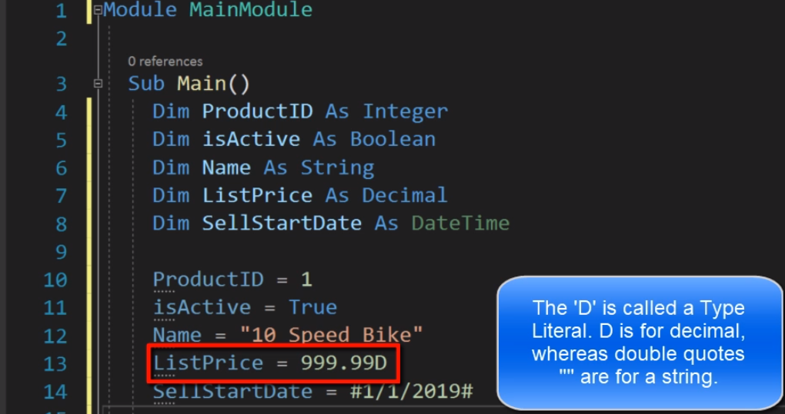
DECLARING AND ASSIGNING VALUES TO VARIABLES

Slide 2
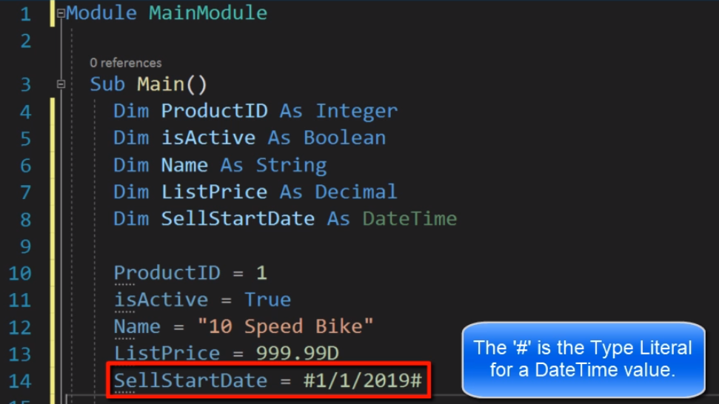
DECLARING AND ASSIGNING VALUES TO VARIABLES

Slide 3
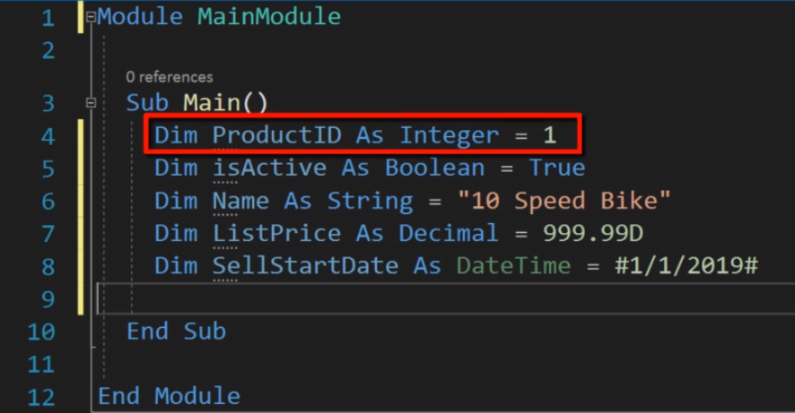
DECLARING AND ASSIGNING VALUES TO VARIABLES

Slide 4
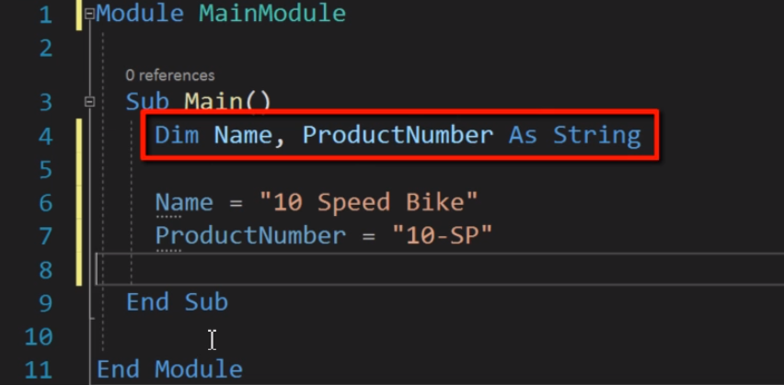
DECLARING SAME TYPE OF VARIABLES

Slide 5
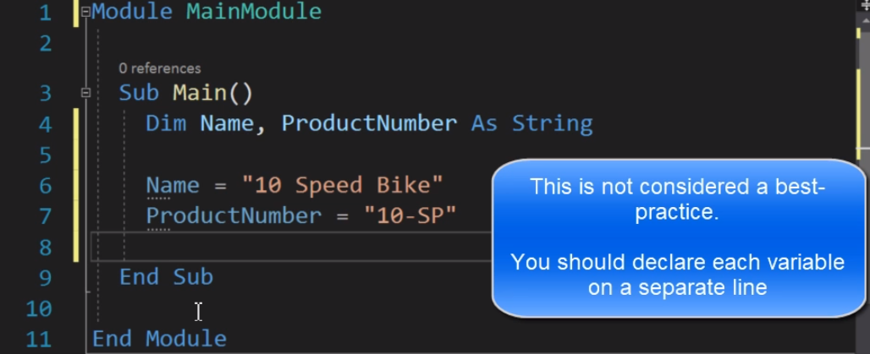
DECLARING SAME TYPE OF VARIABLES

Slide 6
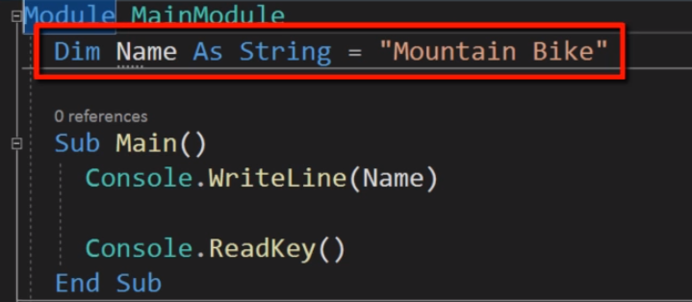
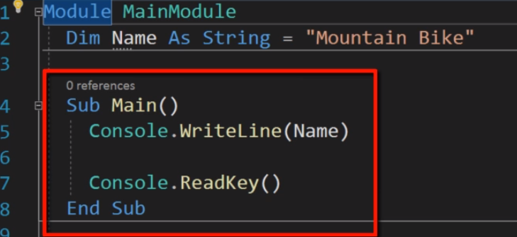
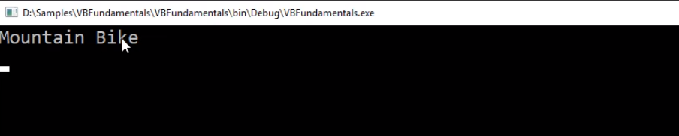
SCOPE OF VARIABLE

Slide 7
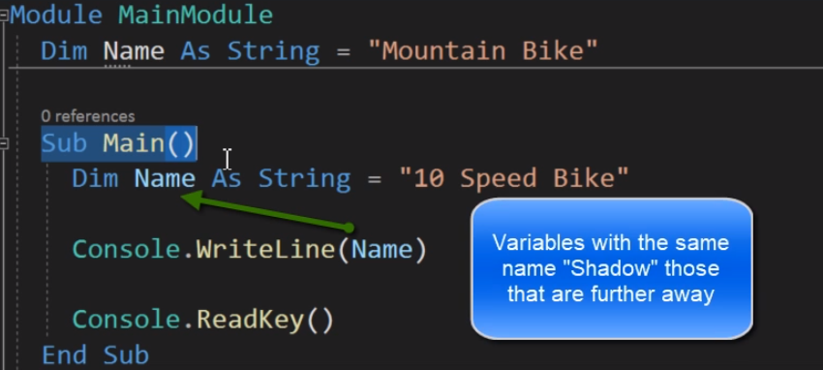
SCOPE OF VARIABLE

Slide 8
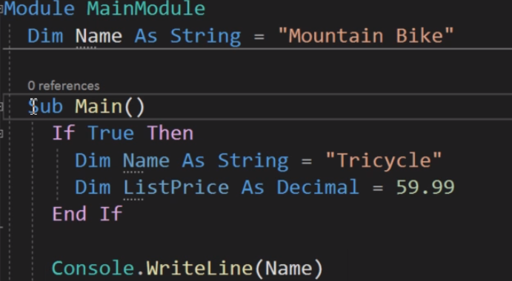
DECLARING SAME TYPE OF VARIABLES

Slide 9
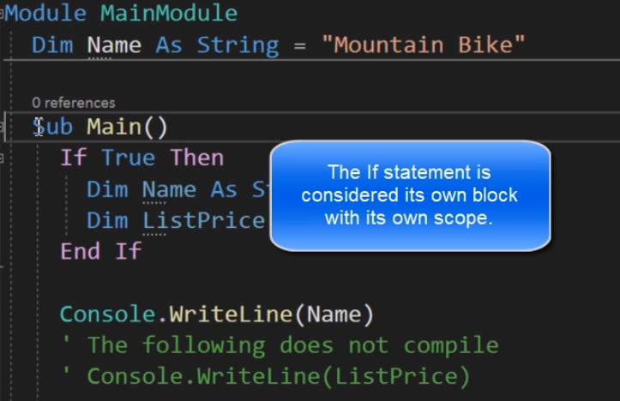
DECLARING SAME TYPE OF VARIABLES

Slide 10
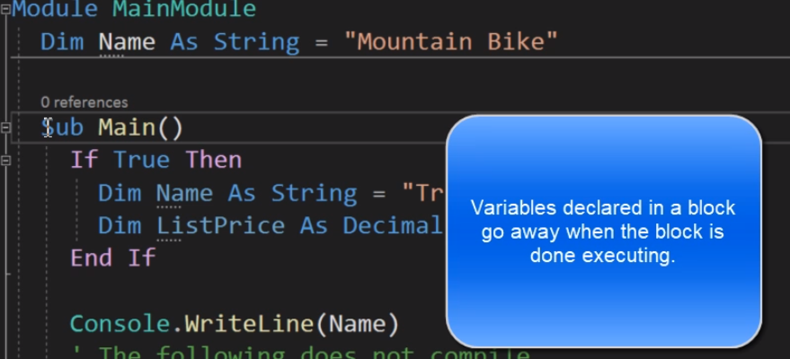
DECLARING SAME TYPE OF VARIABLES

Slide 11
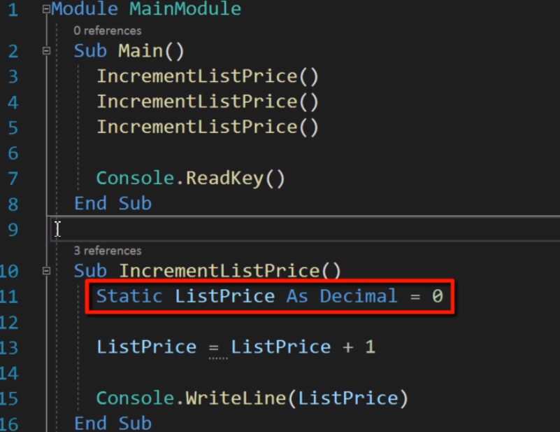
STATIC VARIABLES

Slide 12
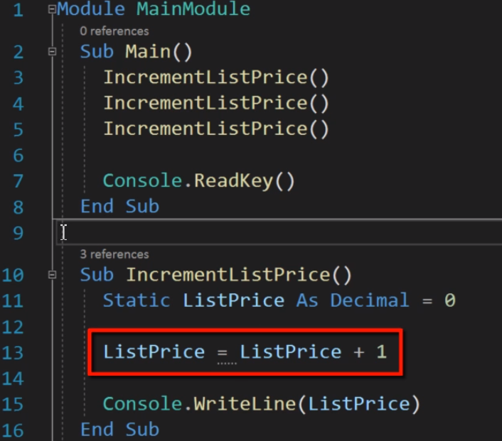
STATIC VARIABLES

Slide 13
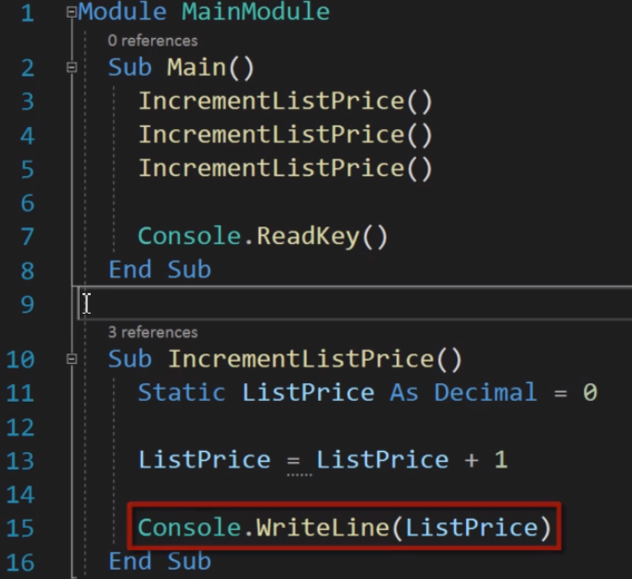
STATIC VARIABLES

Slide 14
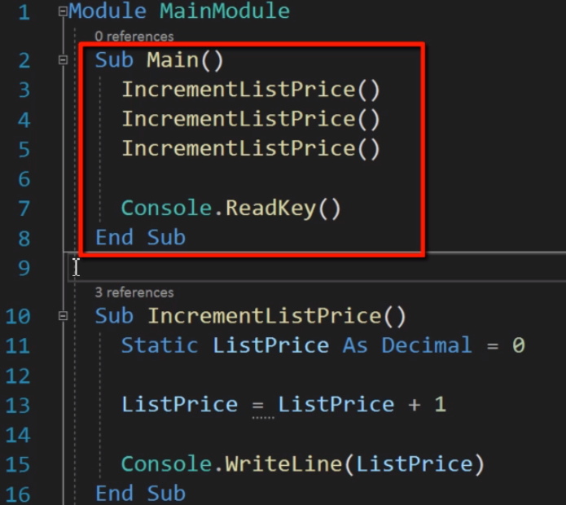
STATIC VARIABLES

Slide 15
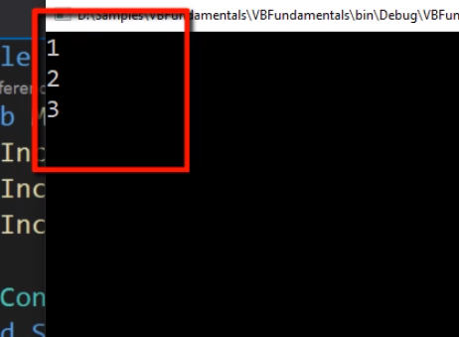
STATIC VARIABLES

Slide 16
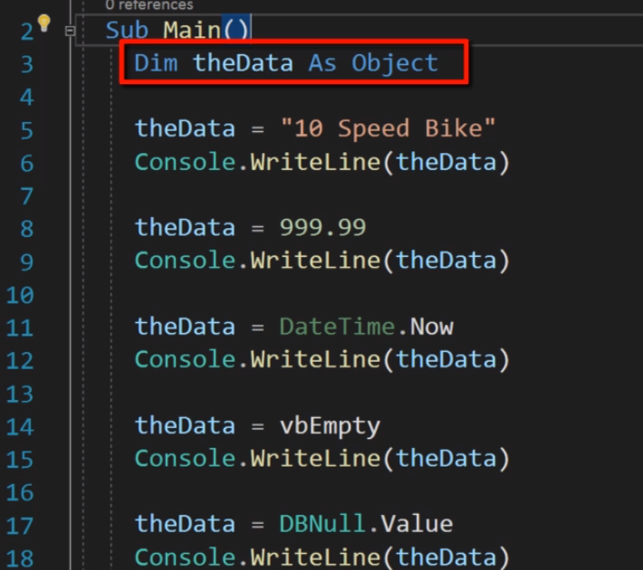
OBJECT DATA TYPE

Slide 17
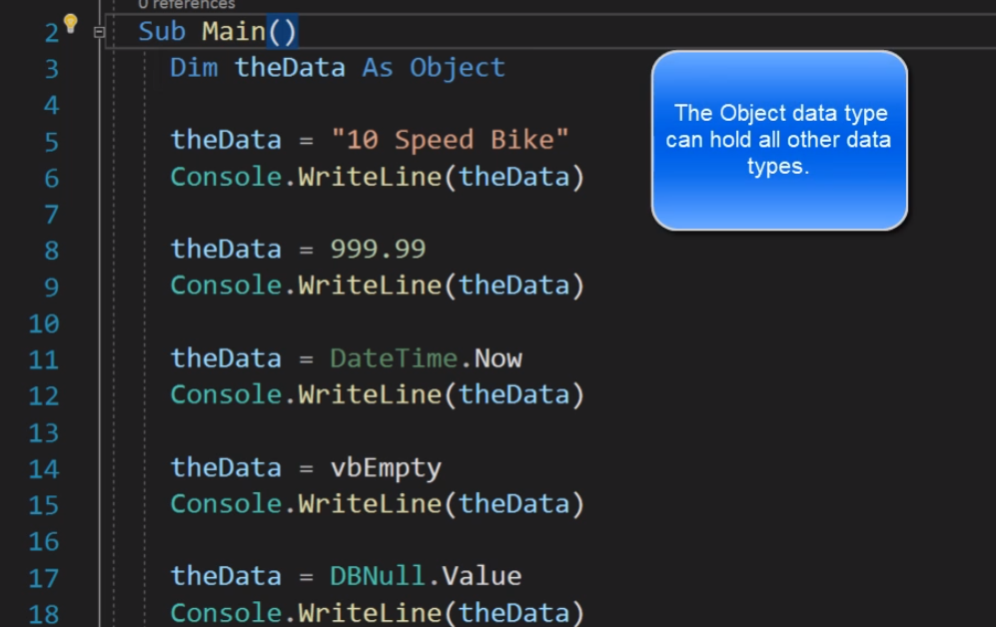
OBJECT DATA TYPE

Slide 18
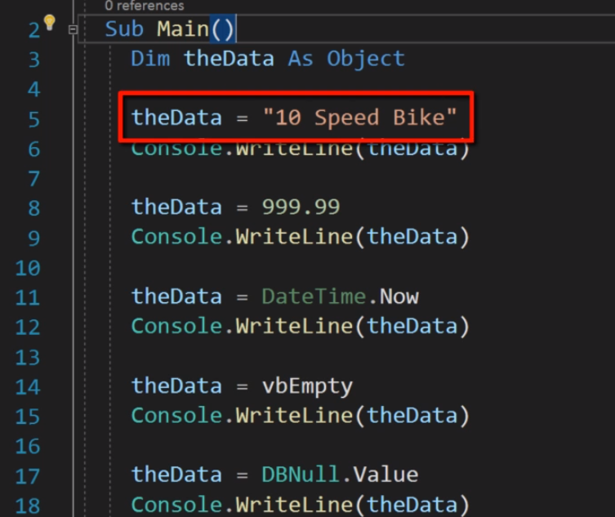
OBJECT DATA TYPE

Slide 19
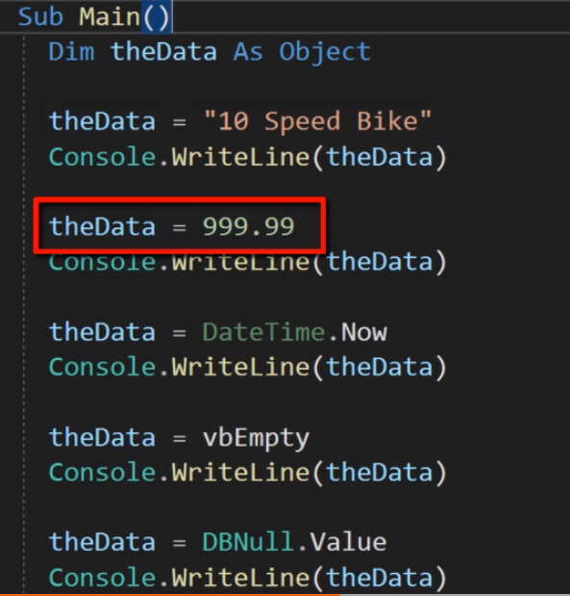
OBJECT DATA TYPE

Slide 20
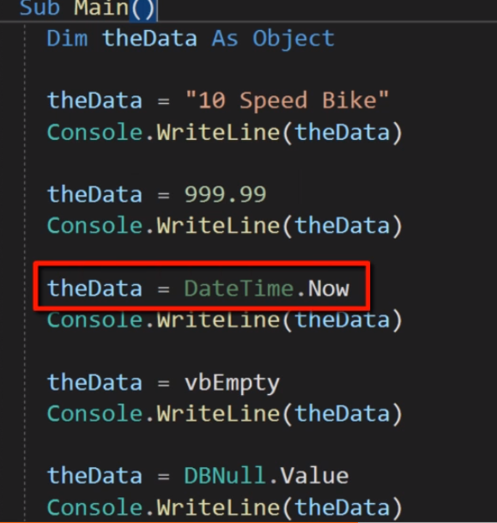
OBJECT DATA TYPE

Slide 21
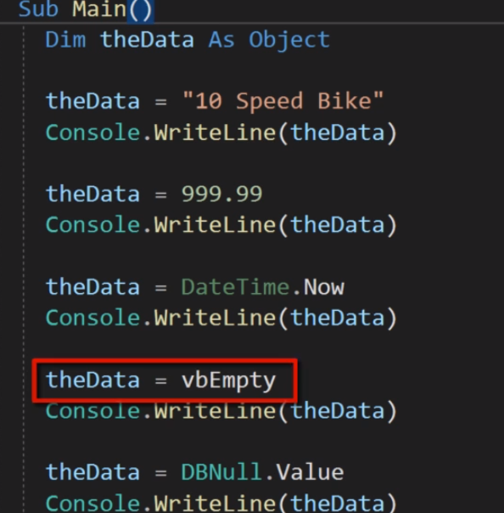
OBJECT DATA TYPE

Slide 22
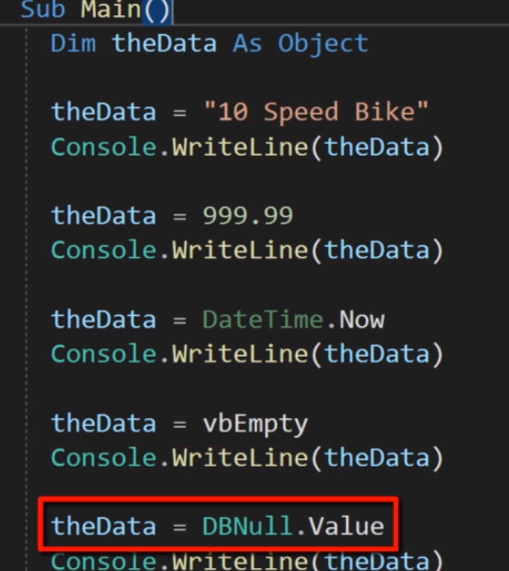
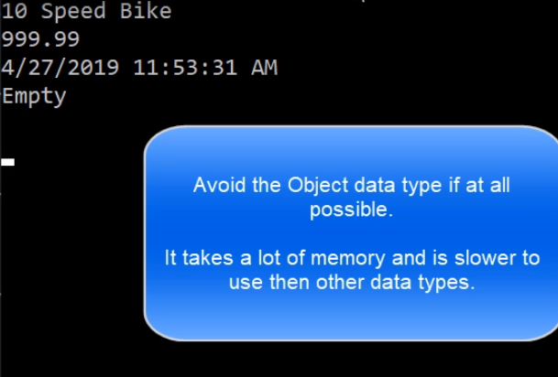
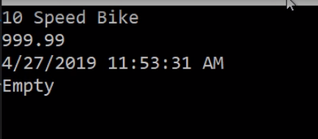
OBJECT DATA TYPE

Slide 23
DECLARE MULTIPLE VARIABLES IN A SINGLE LINE
Dim A, B As Integer, STR As String
Dim A As Integer : Dim B As Double
Note:-
We can specify each variable's data type in the Dim statement. We can also specify an initial value. If we do not, Visual Basic uses default settings.
We can use Dim only at module or procedure level.
Undeclared variables and variables declared without data types are assigned the Object data type but it can cause slow execution.

Slide 24
INITIALIZATION OF VARIABLE
Dim A As Integer = 1
Dim A As Integer = 1, B As Double = 2
Dim A As Integer = 1 : Dim B As Double = 2
Dim STR As String = "HELLO"
Dim STR As String = "THIS IS A LONG SENTENCE" _
& "WHICH WE WANT TO PRINT"
Dim a As Integer = 1 _
& 2
Note1: By default variables are of Object type when not declared.
Note2: Default values for all numeric type are 0,binary 0 for char type, False for Boolean and Nothing for reference type (e.g. string, etc)

Slide 25
HOW TO DECLARE CONSTANT
We use the Const keyword to declare a constant and set its value.
Once a constant is declared, it cannot be modified or assigned a new value.
Example:-
Const pie As Decimal = 3.14
Private Const Days = 7
Public Const Funday As String = "Sunday"

Slide 26
TYPE CASTING OR CONVERSION
Example:-
Dim salary As decimal=10000.58
Dim RoundOffSalary As integer
WIDENING CONVERSIONS
NARROWING CONVERSIONS

Slide 27
WIDENING CONVERSIONS
In Widening conversion we promote a variable of lower type to higher type like char to integer, integer to long, decimal, single, double .
Example:-
Dim num1 As Integer =35786
Dim num2 As double
num2=num1
Here conversion is done automatically by assigning integer value to double (floating) variable.
It always succeed at run time and never incur data loss and always performed implicitly.

Slide 28
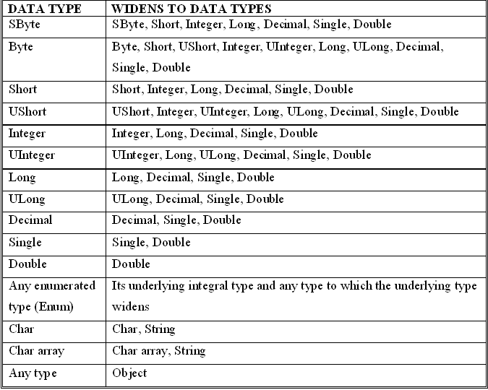
The following table shows the standard widening conversions:

Slide 29
NARROWING CONVERSIONS
In Narrowing conversion data is loss because of demotion of variable.
So, in order to avoid such type of Type Casting is also known as Forced Conversion.
In Type Casting value of higher data type is converted(or cast) into the value of a lower data type.
Example:-
Dim salary As decimal=10000.58
Dim RoundOffSalary As integer
RoundOffSalary =CDec(salary)

Slide 30
NARROWING CONVERSIONS
Example:
Dim num1 As Integer =35786
Dim num2 As Short
num2=num1
Here Narrowing conversion take place so compiler doesn’t allow to perform implicitly. Here overflow exception occurred.
Widening conversions always succeed, they do not throw exceptions. Narrowing conversions, when they fail, most commonly throw the following exceptions:
InvalidCastException :- if no conversion is defined between the two types
OverflowException :- if the converted value is too large for the target type

Slide 31
NOTE:
By definition, every data type widens to itself.
You can always perform them implicitly, whether the Option Strict Statement sets the type checking switch to On or to Off.

Slide 32
NARROWING CONVERSIONS
In Narrowing conversion demotion take place as opposed to promotion in Widening Conversion.
Narrowing conversion changes a value to a data type that might not be able to hold some of the possible values.
Example:
Dim num1 As decimal=3.5
Dim num2 As integer
num2=num1
Here num1 is demoted to integer type and thereby fraction part value is lost.

Slide 33
NARROWING CONVERSIONS
The standard narrowing conversions include the following:
The reverse directions of the widening conversions in the preceding table (except that every type widens to itself)
Conversions in either direction between Boolean and any numeric type
Conversions in either direction between String and any numeric type, Boolean, or Date
The compiler does not allow you to perform narrowing conversions implicitly unless the Option Strict Statement sets the type checking switch to Off.

Slide 34
CTYPE FUNCTION
The CType Function is an alternative conversion function available in VB.NET which can be used for for any kind of type conversion.
It takes 2 arguments; first argument specifies value to be converted and second argument specifies typename to which value is to be converted.
Example:-
Dim Number As Long = 1000
Dim NewNumber As Single = CType (Number, Single)

Slide 35
TRYCAST FUNCTION
It is also a type conversion function which is used for any kind of reference type conversion that does not throw an exception.
If an attempted conversion fails then CType throws InvalidCastException error which can adversely affect the performance of application where as TryCast returns nothing instead of having to handle a possible exception.

Slide 36
FUNCTION NAME | RETURN DATA TYPE
CBool() | Boolean Data Type
CByte() | Byte Data Type
CChar() | Char Data Type
CDate() | Date Data Type
CDbl() | Double Data Type
CDec() | Decimal Data Type
CInt() | Integer Data Type
CLng() | Long Data Type
CObj() | Object Data Type
CSByte() | SByte Data Type
CShort() | Short Data Type
CSng() | Single Data Type
CStr() | String Data Type
CUInt() | UInteger Data Type
CULng() | ULong Data Type
CUShort() | UShort Data Type

Slide 37
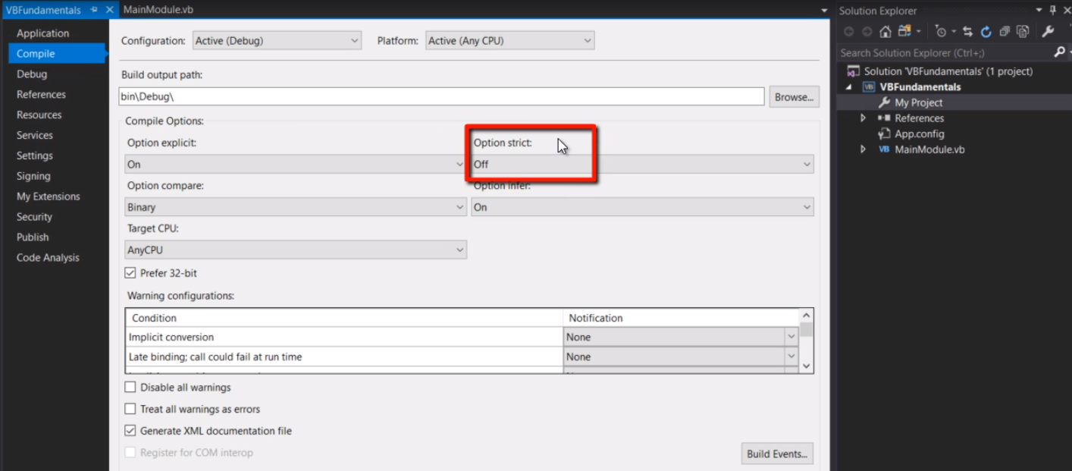
TYPE CONVERSION AND OPTION STRICT

Slide 38
BOXING & UNBOXING
Boxing is the process of converting a value type to the object type or to any reference type implemented by this value.
When the CLR boxes a value type , it wraps the value inside a System.Object and store it on the managed heap.
Unboxing is the reverse of boxing wherein object type is converted into value type.
Note:-Boxing is performed implicitly and Unboxing is performed explicitly.

Slide 39
Ex- Dim num1 As Integer =432
Dim obj As Object
obj=num1 ‘ BOXING PROCESS
Ex- Dim num1 As Integer
Dim obj As Object=432
num1=CInt(obj) ‘ UNBOXING PROCESS

